Slide 1
Data Science – Cosmic Infoset Mining, Modeling and Visualization
BY-
Mr. Subhashish Kumar , Dr. Namrata Dhanda, Mr. Ashutosh Pandey
Mitali Sharma (1911094)

Slide 2
INTRODUCTION
Data science is a multidisciplinary blend of data inference, algorithm development, and technology in order to solve analytically complex problems.
Data science is ultimately about using this data in creative ways to generate business value.
Data Science is a field that encompasses anything related to data cleansing, preparation, and analysis Data is everywhere and is increasing at an infinite rate. In fact, the amount of digital data that exists is thriving at a rapid rate—in fact, more than 2.7 zettabytes of data exist in today’s digital universe, and that is projected to flourish to 180 zettabytes in 2025.
That’s why more organizations of new world are seeking professional workers who can make sense of all the data.

Slide 3
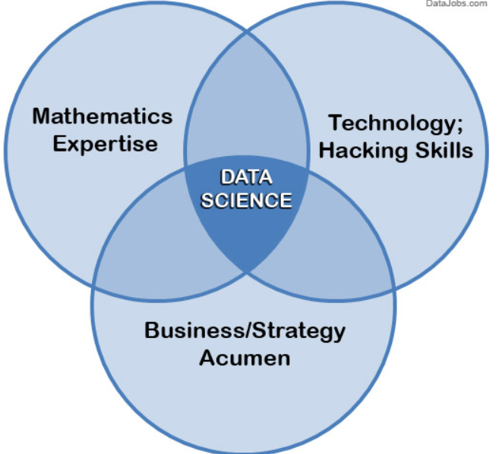
Data science is a blend of skills in three major areas:
Mathematics Expertise
Technology and Hacking
Strong Business Acumen

Slide 4
Mathematics Expertise
Mining data and statically analyzing it, is the main challenge for the data scientists to view the data through logical and quantitative oculus.
There are several attributes of data such as its delicacy, dimension, and correlation in data that can be expressed graphically with some mathematical applications.
Finding panacea by going through the data and making sense of that and predict the next audience target and strategy is bewildering technique.
The main solution for the business related problems involve techniques based on hard math, where being able to view and understand intelligently is another mechanism of those method and that is the key to success in building them.

Slide 5
Strong Business Astute
Data scientist playing major role is expected to be a shrewd, tactical and stalwart business analyzer.
Data scientists are implicated to learn from data in different process, which other can’t do. That makes them perfect in observing the data and reflecting it in a graphical or mathematical manner, and contribute to strategy on solving crux business problems.
This process establishment makes all the critical points intelligible by data visualization. No data-puking – rather, presenting a very clear shadow of data interpretation and solution, by using data visualization as patronage pillars that lead to guidance.

Slide 6
Technology and Hacking
At the beginning, it should be cleared that we are not talking about hacking as in making the information as key by getting into computers. We're referring to the technical coder subculture meaning of hacking – i.e., creativity and inventive in using technical skills to create or generate things and finding tactical solutions to problems as
There are textures, dimensions, and correlations in data that can be expressed mathematically. Finding solutions utilizing data becomes a brain teaser of heuristics and quantitative technique.

Slide 7
PANDAS
Pandas is a BSD-licensed, open source library providing efficient and effective-staging, easy to handle data structure, algorithms and data analysis tools for the Python programming language.
Pandas is a Num FOCUS sponsored project. The success of development of pandas library is ensured by this library as a world-class open-source project, and make it possible to give it for free to world.
It enables the user to proceed ahead for the data manipulation and visualization without aiming for one other domain like R Programming language.

Slide 8
SEABORN :
Sea born is a Python interactive visualization library based on matplotlib. It provides a high-level interface for drawing attractive and user friendly interactive statistical graphics.
Sea born performs to aim at production visualization a central part of exploring and understanding data. Sea born provokes the plot to be user interactive, productive and intelligible with lesser text and more distinct color palettes for better understanding.
Matplotlib makes easy things easy and difficult things possible to interpret but seaborn make a well structured set of difficult things easy too.
NUMPY : NumPy or Numerical Python extension is the fundamental package for scientific computing with Python. Used for similar kind of multidimensional array, also used for doing math related stuff or cosmic amount i.e. big data. It is written in C that’s why it works fast and glibly.
NumPy can also be used as an effective and efficient multi-dimensional container of generic data. Numpy provides the beneficial functions for the numeric games of alteration and visualizing the data set information.

Slide 9
CONCLUSION
The Conclusion of this paper that field of data science is beyond our imagination. This world is full of data is huge, the thing which matter is how we tackle . The future of data expert is bright as demand of data scientists are increasing day by day in the business corporate.

Slide 10
REFERENCES
[1] March, Salvatore T., and Gerald F. Smith. "Design and natural science research on information technology." Decision support systems 15.4 (1995).
[2] Peffers, Ken, et al. "A design science research methodology for information systems research." Journal of management information systems 24.3 (2007)
[3] https://www.simplilearn.com/data-science-vs-big-data-vs-dataanalytics-article.
[4] Baker, Ryan SJD, and Kalina Yacef. "The state of educational data mining in 2009: A review and future visions." JEDM| Journal of Educational Data Mining 1.1 (2009).
[5] https://en.wikipedia.org/wiki/Data_scienceI.S. Jacobs and C.P. Bean, “Fine particles, thin films and exchange anisotropy,” in Magnetism, vol. III, G.T. Rado and H. Suhl, Eds. New York: Academic, 1963, pp. 271-350.
[6] https://datajobs.com/what-is-data-science
[7] https://pandas.pydata.org/
[8] http://www.numpy.org/
[9] https://seaborn.pydata.org/
[10] https://en.wikipedia.org/wiki/Data_science
[11] https://docs.python.org/3/tutorial/

Slide 11
STRATEGY FOR IMPLEMENTATION
To explain the modeling and statically visualisation , take the data sheet of Fifa Championship which will include the past data.
By using the libraries pandas, matplotlib.pyplot ,numpy and using data , the potential of the top ten strong Countries will be shown in the form of pie graph.
And it also represent the age group having their potential growth and declination.
These techniques are used in world class sports and these predict the data too.

Slide 12
THANK YOU

